Slide 1

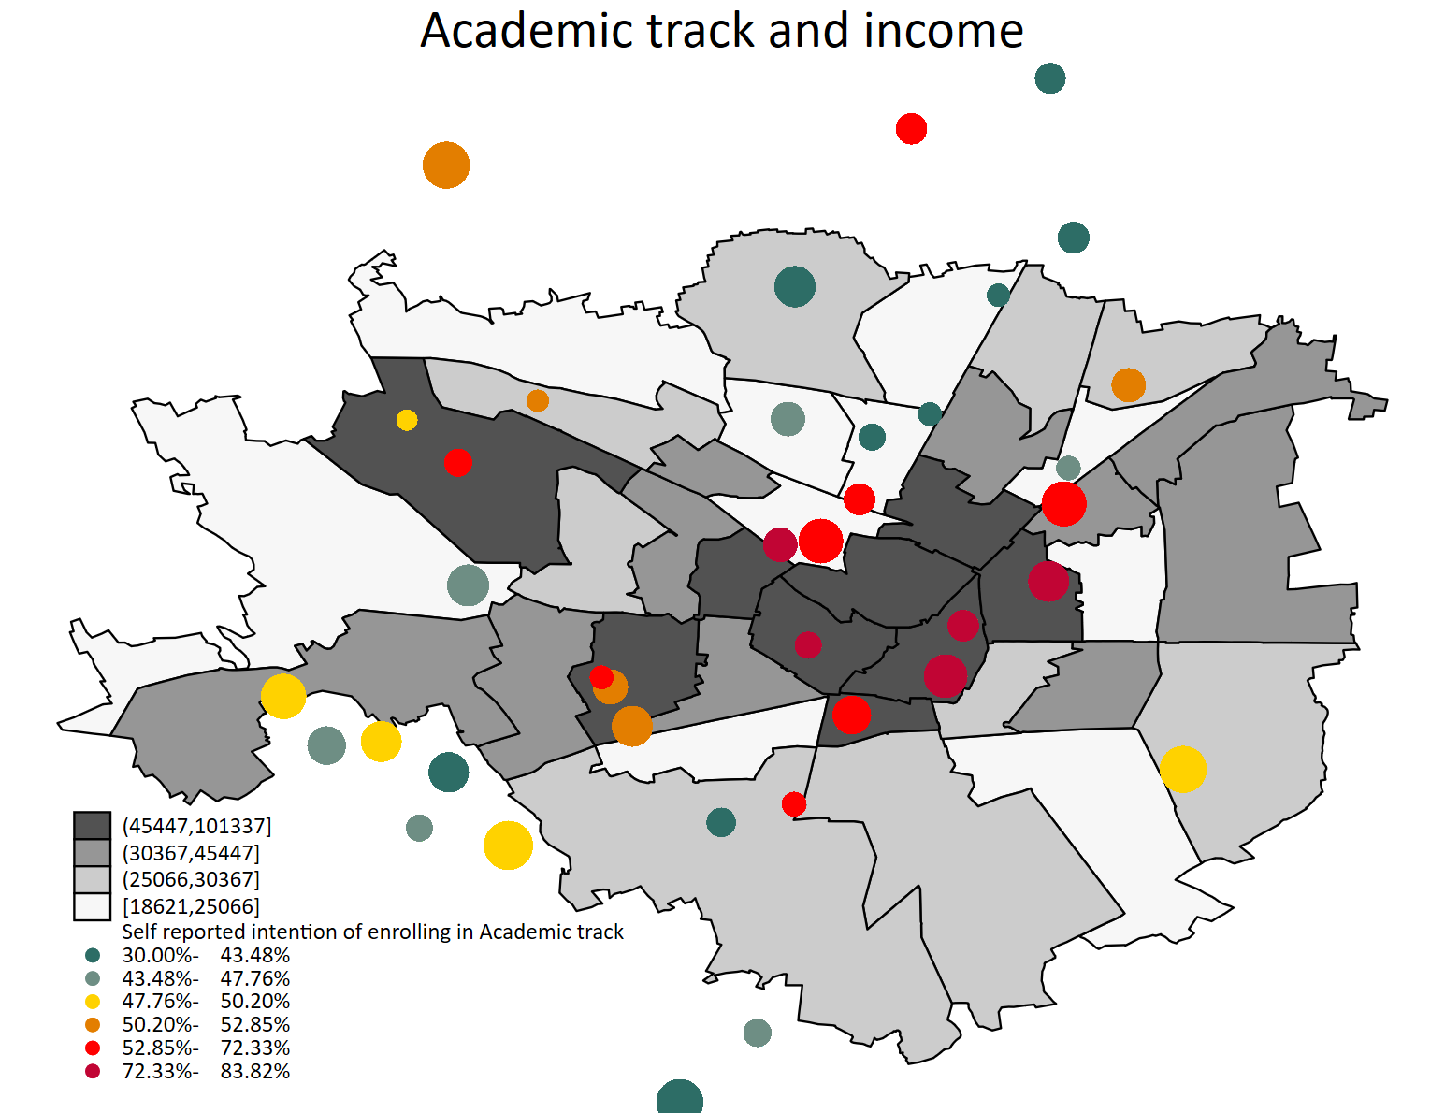

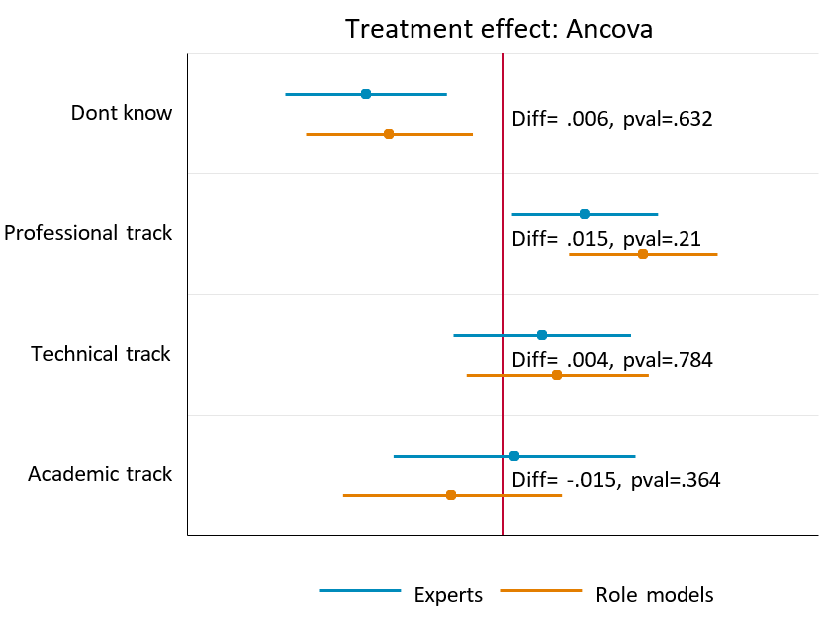
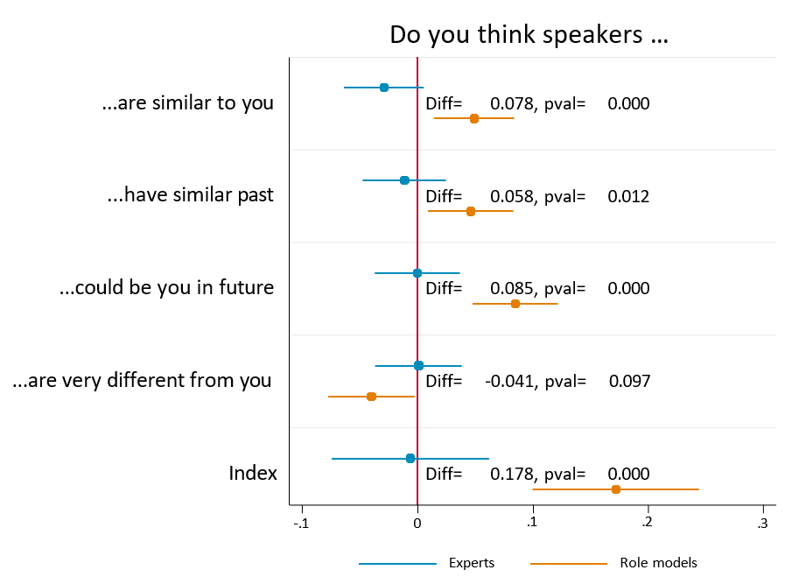
Project WIDEHO –
WIDEning the HOrizons
Selene Ghisolfi ^{[1,2,3]} , Giovanna Marcolongo^{[2,4]} , Diletta Savoldi ^{[2]}
[1] UCSC [2] SiLab Bocconi [3] LEAP Bocconi [4] CLEAN Bocconi
Provide information about academic paths, their relative career outlets, the job market
Combat bias against specific types of schools by showing what is studied at each school
Timely information-from the beginning of
first grade of middle school
Assess impact rigorously:
                Data collection with return of a customized report for each participating institution, showing average data for each school-and not for the entire sample.
  Follow students over the long term to assess the quality of choice, measuring reorientation and dropout.
Provide complementary information to the orientation usually offered-“what school addresses are there?” instead of
“know thyself”
Project objectives
One hour meetings per school
Report per school
Middle schools
Classes 1st, 2nd , 3rd
40
245
3
1
The problem
Academic achievements: grades and INVALSI tests
Academic effort: attendance and demerits
High-school choices
Reorientation and dropout
Aspirations: “What do you want to be when you grow up?”
Self-reported beliefs on their probability of success
Identification of the student with the role model/career expert
Information on careers
Self-esteem, self-efficacy, optimism: measured in the survey.
The intervention
The intervention consists of three meetings per class. Each meeting is a one-hour classroom information sessions conducted by experts trained by the project.
INCONTRO 1
INCONTRO 2
INCONTRO 3
Information on high schools
Liceo,
content and opportunities
Technical,
content and opportunities
Vocational, content and opportunities
Information on the job market
The job market
The workforce
Work: right or duty
Measured outcomes
All classes in participating schools will receive one of the two paths: which one will be determined randomly. In each school, one-third of the involved classes will receive the job market information, two-thirds the high school type information.
Results

